Slide 1
Email Spam Classification
AAYUSHI 20BCE1791
GARVIT JAKAR 20BCE1838

Slide 2
NATURAL LANGUAGE PROCESSING
Presented to
- Dr. Premalatha L

Slide 3
Agenda
Abstract
Introduction
Problem
Problem Statement
Dataset
Algorithms
Libraries
Outcome
Summary

Slide 4
Abstract
Today, spamming email is one of the main difficulties encountered by everyone in the world of the Internet. In such a world, email is mostly shared by everyone to share the information and files because of their easy way of communication and for their low cost. But such emails are mostly affecting the professionals as well as individuals by the way of sending spam emails. Every day, the rate of spam emails and spam messages is increasing. Such spam emails are mostly sent by people to earn income or for any advertisement for their benefit. For those who receive the spam mail, the rising volume of it clogs up traffic and wastes their time. Sometimes, the users easily get trapped into financial fraud actions, by seeing the spam mails such as job alert mails and commercial mails and offer emails. The individual can experience some mental stress as a result. The system has presented a machine learning model to decrease all of these dangers. This model will identify spam and non-spam emails, and it will also optimise the data by deleting undesirable emails that contain advertisements, as well as some pointless and fraudulent emails.

Slide 5
Introduction
Email spam has grown significantly in recent years along with the rapid expansion of internet users. They are being used for fraud, phishing, and other unethical and criminal activities. sending harmful links through unsolicited email, which can damage our system and try to access your system. The spammers target those people who are unaware of these frauds and target them by easily creating phoney profiles and email accounts. In their spam emails, they pose as a real person. Therefore, it is necessary to identify spam emails that contain fraud. This project will do so by utilising machine learning techniques. This article will cover machine learning algorithms and apply all of them to our data

Slide 6
Problem
Spam emails can be annoying and are of no use for the users.
Spamming includes mass mailing, sending viruses with emails and phishing.

Slide 7
Why this is such a big problem?
The main problem arises when we miss relevant emails and information because of spamming.

Slide 8
Problem statement
This is a supervised learning problem given in a text (email) classify it as a spam or not spam. We will be using Naïve bayes and Support vector machine (SVM) for solving the problem.

Slide 9
Dataset Description
It contains 3 columns and 2964 rows with column values named subject, message and label. Subject refers to the topic of the email that is being talked about in the corresponding message section and label is an important column as it contains binary values i.e. 0 and 1 . 0 stands for NOT SPAM and 1 stands for SPAM. The dataset undergoes certain pre-processing steps to turn it into a clean dataset.

Slide 10
Algorithms used

Slide 11
1. Naïve Bayes Classifier
It is simple probabilistic classifier that calculates a set of probabilities by counting the frequency and combination of values in a given dataset.
It is very useful to classify the emails properly.
It is mathematically calculated as:
P(A|B)=P(B|A)P(A)/P(B)

Slide 12
2. SVM Classifier
SVM or the Support Vector Machine classifier is widely used classifier.
SVM is a binary classifier that tries to find a hyperplane in a high-dimensional space that maximally separates the different classes. The hyperplane is chosen such that it maximizes the margin between the classes, which is the distance between the hyperplane and the nearest data points from each class.

Slide 13
3. Count Vectorizer
Count Vectorizer is a text feature extraction algorithm used for converting a collection of text documents to a matrix of token counts. The algorithm works by counting the number of times each word (or token) appears in a text document and then encoding this information as a sparse matrix.

Slide 14
Libraries used

Slide 15
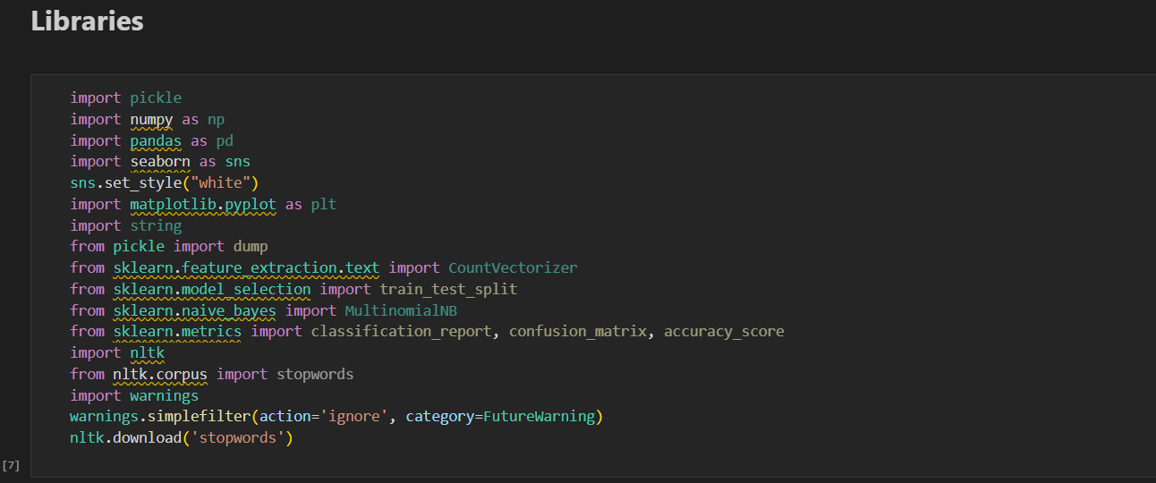

Slide 16
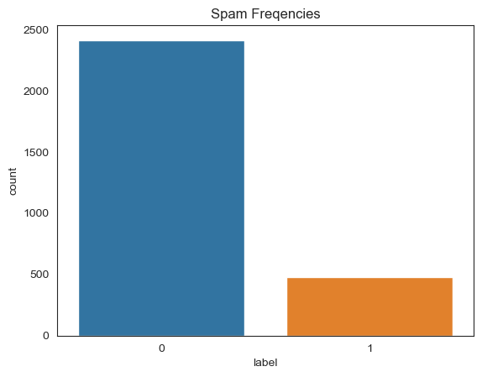
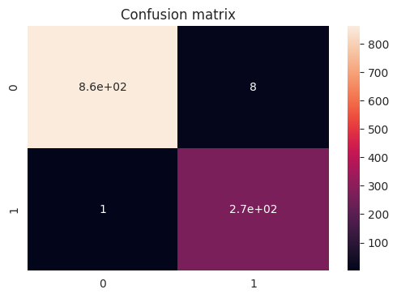
Outcome of the project
Checking the spam frequency label wise
Confusion matrix

Slide 17
Summary
E-mail spam filtering is an important issue in the network security. Naïve Bayes classifier that used has a very important role in this process and its quality of performance is also based on datasets that is being used. Naïve Bayes classifier also can get high precision that give high percentage of spam message manage to block if the dataset collect from single e-mail accounts. In our project, Naïve Bayes gave the accuracy of around 86% while SVM was accurate up to 96%.

Slide 18
Thank you

